Slide 1
DIWALI 2025

Slide 2
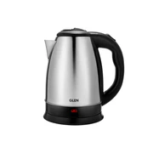
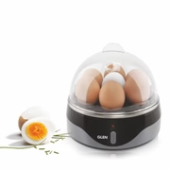
S.NO | PRODUCT DETAIL | PRODUCT CODE | IMAGE | SPECIFICATION | MRP | OFFER PRICE Basic
1 | Electric Kettle 1.8 Litre Stainless Steel with 360° Rotational Base, 1350 W | Silver (9002) |  | A compact kettle that is designed to fit into most spaces - Concealed heating element for your safety - Boil up to 1.8ltr of water in one go - Easy to clean with a stable base to prevent spills - A 360° rotational base for convenience - 1 year warranty | 1395 | 480
2 | Egg Boiler Boils 7 Eggs, 1 Poaching Cup, Auto shut Off, 350W | 3030EB7 |  | Allows convenient boiling of 7 eggs at a time - Comes with a Poaching egg cup - Equipped with automatic off feature that cuts off the supply after the water is finished - 350W Power - 1 Years Warranty | 1295 | 590

Slide 3
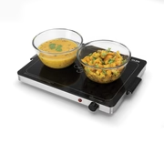
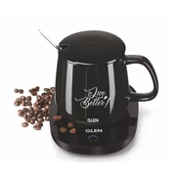
S.NO | PRODUCT DETAIL | PRODUCT CODE | IMAGE | SPECIFICATION | MRP | OFFER PRICE Basic
3 | Electric Warmer Plate with Auto Shut Off 300W | SA 3001 |  | Warmer plate keeps food warm and ready to serve - Use only heat resistant cookware - Even heat distribution - Easy to clean glass top - Ultra thin & sleek space saving design - Perfect for any table top/counter - Energy efficient: low power consumption | 2995 | 1270
4 | Electric Coffee Mug Warmer Plate with Auto Shut Off and Heating Function 16 Watt | SA 3000 |  | All-day warming keeps tea or coffee warm or lukewarm through the entire day - 50-55°C warm water level in 60 minutes, depending on input water temperature - Gravity-operated auto shut off, switches on when a filled cup is placed, and off when removed - 16W power consumption for energy-efficient all-day warming - 400ml mug included, specially designed with a stirrer and a matching ceramic lid - Tubular heating element for better, more even heating - Flat pan compatible for warming soups and tiffin on the plate | 1595 | 703

Slide 4
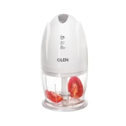
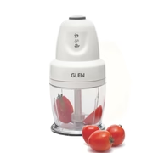
S.NO | PRODUCT DETAIL | PRODUCT CODE | IMAGE | SPECIFICATION | MRP | OFFER PRICE Basic
5 | Electric Mini Chopper, Stainless Steel Blade, Vegetable, Nuts Chopper, 0.4 Litres Bowl, 200W | White (4041MC) |  | A 400 ml bowl for chopping small quantities - Push button switch for easy operation - High quality rust resistant stainless steel blades for impeccable chopping - Anti-skid base for a stable chopping experience - Certified by Bureau of Indian Standards | 2295 | 890
6 | Electric Vegetable Chopper, Whisking Disc Chops Nuts 0.4 Litres Bowl, 250W | White (4043) |  | A 400 ml bowl for chopping small quantities - Push button switch and a whisking disk for easy blending - High quality rust resistant stainless steel blades for impeccable chopping - Anti-skid base for a stable chopping experience - 2 year warranty | 2395 | 935

Slide 5
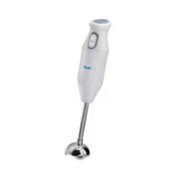
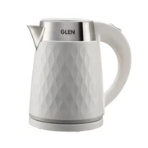
S.NO | PRODUCT DETAIL | PRODUCT CODE | IMAGE | SPECIFICATION | MRP | OFFER PRICE Basic
7 | Electric Hand Blender with Stainless Steel Arm 200W | White (4049) |  | A handheld blender that’s easy to use - One push button switch that’s conveniently placed - High quality detachable stainless steel blades - Low noise design for a comfortable blending experience - ISI certified - 2 year warranty | 2295 | 890
8 | Electric Kettle 1.8 Litre Plastic Clad Stainless Steel, 360° Rotation Base, Auto Shutoff, 1500 W | White (9005) |  | Capacity 1.8L - Auto shut OFF - Concealed heating element - Convenient 360° rotational base - Well positioned & shaped handle, easy & cool to hold - Power 1500W | 2295 | 960

Slide 6
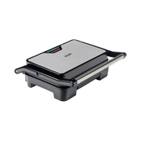
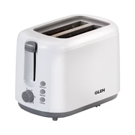
S.NO | PRODUCT DETAIL | PRODUCT CODE | IMAGE | SPECIFICATION | MRP | OFFER PRICE Basic
9 | Press Grill with Non-stick Plates Oil Collector Tray 850W Power | 3029GRILL |  | Contact Grill makes cooking faster and easier - Strong handle giving a stylish look and safety - Oil collector tray ensures less grease on the grill - 850 W - Heavy duty non stick plates to keep the food healthy - 2 years warranty | 3195 | 1450
10 | Electric Auto Pop-up 2 Slice Toaster, 750W, 6 Level Browning Control, Removable Crumb Tray | White (3019) |  | 2 Slice toaster for different thickness of breads - 6 Level browning control delivers toasted bread in less time - Slide out crumb tray can be conveniently removed and cleaned - Extra lift carriage control for convenient removal of slices - Defrost, Reheat & Cancel buttons for added advantage | 2895 | 1290

Slide 7
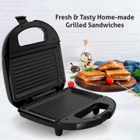
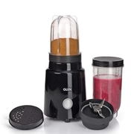
S.NO | PRODUCT DETAIL | PRODUCT CODE | IMAGE | SPECIFICATION | MRP | OFFER PRICE Basic
11 | Electric Sandwich Maker Grill with Non-Stick Coating Plates, 750W | Black (3024BGRILL) |  | Comes with grill plates to make healthy food - Fresh & Tasty Home-made Grill Sandwiches - With non-stick coating on plates cleaning becomes easy - Thermostat control ensures even cooking - Has cool-touch handle and light indicators for better efficiency - Vertical staking - Consumes 750 W power - 2 years warranty | 2095 | 940
12 | Active-Blender, 350W, 20000 RPM Mixer, Grinder, Blender, 2 Unbreakable Food Grade Jars | 4048 N |  | 350W motor at 20,000 RPM for blending and grinding in seconds - 2 unbreakable food-grade jars, a 500 ml blending jar, and a 300 ml grinding jar - 2 interchangeable blades in rust-resistant stainless steel for wet and dry use - Push button pulse operation with a 1-minute maximum run time per cycle - Lid and seasoning cap for storing blends and using ground spices straight from the jar - ISI Certified for tested safety and quality - Warranty: 2 years. We trust our products; you can too. | 4195 | 1450

Slide 8
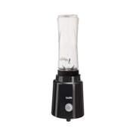
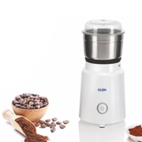
S.NO | PRODUCT DETAIL | PRODUCT CODE | IMAGE | SPECIFICATION | MRP | OFFER PRICE Basic
13 | Electric Personal Blender 200W 0.6 Litres BPA free Bottle with carry handle | Black (4047 BL) |  | A 600ml all-in-one blend, carry and sip bottle. - One push button switch that’s easy to use - High quality rust resistant stainless steel blades for impeccable blending - ISI certified - 2 year warranty | 3295 | 1210
14 | Electric Mini Grinder, 50gm SS Jar for Dry and Wet Grinding 350W | White (4045 NG) |  | A 50g grinder, perfect for grinding your coffee everyday - Push button switch that’s easy to use - High quality rust resistant stainless steel blades - ISI certified - 2 year warranty | 3095 | 1199

Slide 9
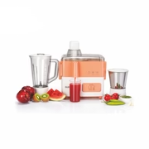
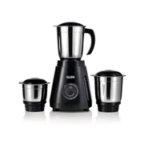
S.NO | PRODUCT DETAIL | PRODUCT CODE | IMAGE | SPECIFICATION | MRP | OFFER PRICE Basic
15 | 3-in-1 Juicer Mixer Grinder with 2 Jars 500 watt Power | SA4012JAR2 |  | - 2 jars of varying capacities to perform all the pre-cooking functions effortlessly - Rust resistant stainless steel blades to ensure a longer lifespan - Overload Protector Mechanism for your safety - 2 speed settings with pulse function - Comes with a 2 year standard warranty | 4595 | 1970
16 | Mixer Grinder 550W with 3 Stainless Steel Liquidiser, Grinder and Chutney Jars | Black (4021) |  | - 3 stainless steel jars of varying capacities to meet all your grinding needs - Low noise design for your convenience - Rust resistant stainless steel blades to ensure a longer lifespan - 550W Powerful motor - Overload Protector Mechanism for your safety - ISI certified - 3 speed settings with pulse function - Comes with a 2 year standard warranty | 4495 | 1720

Slide 10
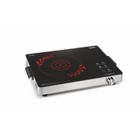
S.NO | PRODUCT DETAIL | PRODUCT CODE | IMAGE | SPECIFICATION | MRP | OFFER PRICE Basic
17 | Infrared Cooking Stove with 4 Preset Cooking Functions 2200W | SA-3077IR |  | - 4.5 kV surge protection to safeguard the PCB from Voltage fluctuations - Stainless Steel Frame - Stainless Steel Grill Rack Included for Barbeque - Crystal Glass Plate (360x280 mm) - Digital display - 4 Pre-Set Functions - Extra Wide Cooking Surface - Touch Sensor Control - 180 minutes timer - Cool touch handle - Power Range (100-2200 WATT) - Suitable for all flat bottom pots and pans - 2200 W | 5295 | 2070

